Slide 1
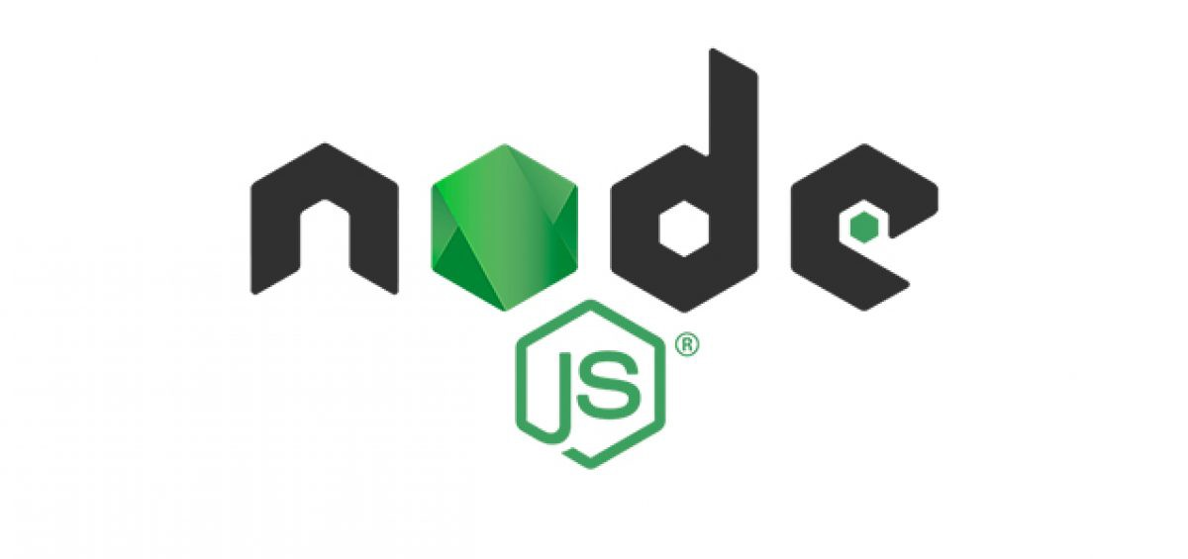
Full Stack Development -
MEAN Stack

Slide 2
What is Node.js?
Node.js is an open source server environment
Node.js is free
Node.js runs on various platforms (Windows, Linux, Unix, Mac OS X, etc.)
Node.js uses JavaScript on the server

Slide 3
Why Node.js?
Here is how Node.js handles a file request:
Sends the task to the computer's file system.
Ready to handle the next request.
When the file system has opened and read the file, the server returns the content to the client.
Node.js eliminates the waiting, and simply continues with the next request.
Node.js runs single-threaded, non-blocking, asynchronously programming, which is very memory efficient

Slide 4
What Can Node.js Do?
Node.js can generate dynamic page content
Node.js can create, open, read, write, delete, and close files on the server
Node.js can collect form data
Node.js can add, delete, modify data in your database

Slide 5
What is a Node.js File?
Node.js files contain tasks that will be executed on certain events
A typical event is someone trying to access a port on the server
Node.js files must be initiated on the server before having any effect
Node.js files have extension ".js"

Slide 6
Node.js Get Started
Once you have downloaded and installed Node.js on your computer, let's try to display "Hello World" in a web browser.
Create a Node.js file named "myfirst.js", and add the following code:
myfirst.js
var http = require('http');
http.createServer(function (req, res) {
res.writeHead(200, {'Content-Type': 'text/html'});
res.end('Hello World!');
}).listen(8080);

Slide 7
Node.js MongoDB
Node.js can be used in database applications.
One of the most popular NoSQL database is MongoDB.

Slide 8
Node.js MongoDB Create Database
var MongoClient = require('mongodb').MongoClient;
var url = "mongodb://localhost:27017/mydb";
MongoClient.connect(url, function(err, db) {
if (err) throw err;
console.log("Database created!");
db.close();
});

Slide 9
Node.js MongoDB Create Collection
var MongoClient = require('mongodb').MongoClient;
var url = "mongodb://localhost:27017/";
MongoClient.connect(url, function(err, db) {
if (err) throw err;
var dbo = db.db("mydb");
dbo.createCollection("customers", function(err, res) {
if (err) throw err;
console.log("Collection created!");
db.close();
});
});

Slide 10
Node.js MongoDB Find
Find One
To select data from a collection in MongoDB, we can use the findOne() method.
The findOne() method returns the first occurrence in the selection.
The first parameter of the findOne() method is a query object. In this example we use an empty query object, which selects all documents in a collection (but returns only the first document).

Slide 11
var MongoClient = require('mongodb').MongoClient;
var url = "mongodb://localhost:27017/";
MongoClient.connect(url, function(err, db) {
if (err) throw err;
var dbo = db.db("mydb");
dbo.collection("customers").findOne({}, function(err, result) {
if (err) throw err;
console.log(result.name);
db.close();
});
});

Slide 12
Node.js MongoDB Sort
var MongoClient = require('mongodb').MongoClient;
var url = "mongodb://localhost:27017/";
MongoClient.connect(url, function(err, db) {
if (err) throw err;
var dbo = db.db("mydb");
var mysort = { name: 1 };
dbo.collection("customers").find().sort(mysort).toArray(function(err, result) {
if (err) throw err;
console.log(result);
db.close();
});
});

Slide 13
Node.js REPL (READ, EVAL, PRINT, LOOP)
REPL (READ, EVAL, PRINT, LOOP) is a computer environment similar to Shell (Unix/Linux) and command prompt. Node comes with the REPL environment when it is installed. System interacts with the user through outputs of commands/expressions used. It is useful in writing and debugging the codes. The work of REPL can be understood from its full form:
Read : It reads the inputs from users and parses it into JavaScript data structure. It is then stored to memory.
Eval : The parsed JavaScript data structure is evaluated for the results.
Print : The result is printed after the evaluation.
Loop : Loops the input command. To come out of NODE REPL, press ctrl+c twice

Slide 14
Node.js - Callbacks Concept
Callback is an asynchronous equivalent for a function. A callback function is called at the completion of a given task.
Node makes heavy use of callbacks. All the APIs of Node are written in such a way that they support callbacks.
var fs = require("fs");
var data = fs.readFileSync('input.txt');
console.log(data.toString());
console.log("Program Ended");

Slide 15
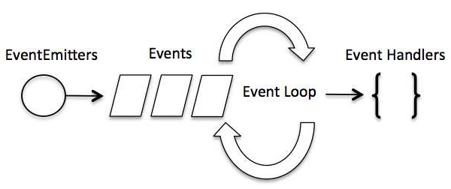
Node.js - Event Loop

Slide 16
Although events look quite similar to callbacks, the difference lies in the fact that callback functions are called when an asynchronous function returns its result, whereas event handling works on the observer pattern.
The functions that listen to events act as Observers. Whenever an event gets fired, its listener function starts executing.

Slide 17
EventEmitter Object
You can assign event handlers to your own events with the EventEmitter object.
In the example below we have created a function that will be executed when a "scream" event is fired.
To fire an event, use the emit() method.

Slide 18
var events = require('events');
var eventEmitter = new events.EventEmitter();
//Create an event handler:
var myEventHandler = function () {
console.log('I hear a scream!');
}
//Assign the event handler to an event:
eventEmitter.on('scream', myEventHandler);
//Fire the 'scream' event:
eventEmitter.emit('scream');

Slide 19
Node.js - Buffers
Method 1
Following is the syntax to create an uninitiated Buffer of 10 octets −
var buf = new Buffer(10);
Method 2
Following is the syntax to create a Buffer from a given array −
var buf = new Buffer([10, 20, 30, 40, 50]);

Slide 20
Method 3
Following is the syntax to create a Buffer from a given string and optionally encoding type −
var buf = new Buffer("Simply Easy Learning", "utf-8");
Though "utf8" is the default encoding, you can use any of the following encodings "ascii", "utf8", "utf16le", "ucs2", "base64" or "hex".

Slide 21
Writing to Buffers
Parameters
Here is the description of the parameters used −
string − This is the string data to be written to buffer.
offset − This is the index of the buffer to start writing at. Default value is 0.
length − This is the number of bytes to write. Defaults to buffer.length.
encoding − Encoding to use. 'utf8' is the default encoding.

Slide 22
Reading from Buffers
Parameters
Here is the description of the parameters used −
encoding − Encoding to use. 'utf8' is the default encoding.
start − Beginning index to start reading, defaults to 0.
end − End index to end reading, defaults is complete buffer.

Slide 23
Convert Buffer to JSON
Syntax
Following is the syntax of the method to convert a Node Buffer into JSON object −
buf.toJSON()
Return Value
This method returns a JSON-representation of the Buffer instance.

Slide 24
Concatenate Buffers
Compare Buffers
Copy Buffer
Slice Buffer
Buffer Length

Slide 25
What are Streams?
Streams are objects that let you read data from a source or write data to a destination in continuous fashion. In Node.js, there are four types of streams −
Readable − Stream which is used for read operation.
Writable − Stream which is used for write operation.
Duplex − Stream which can be used for both read and write operation.
Transform − A type of duplex stream where the output is computed based on input.

Slide 26
Each type of Stream is an EventEmitter instance and throws several events at different instance of times. For example, some of the commonly used events are −
data − This event is fired when there is data is available to read.
end − This event is fired when there is no more data to read.
error − This event is fired when there is any error receiving or writing data.
finish − This event is fired when all the data has been flushed to underlying system.

Slide 27
Reading from a Stream
Writing to a Stream
Piping the Streams
Chaining the Streams

Slide 28
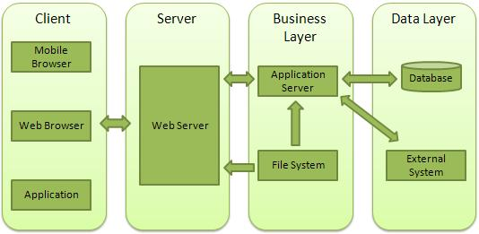
Node.js - Web Module

Slide 29
Client − This layer consists of web browsers, mobile browsers or applications which can make HTTP requests to the web server.
Server − This layer has the Web server which can intercept the requests made by the clients and pass them the response.
Business − This layer contains the application server which is utilized by the web server to do the required processing. This layer interacts with the data layer via the database or some external programs.
Data − This layer contains the databases or any other source of data.

Slide 30
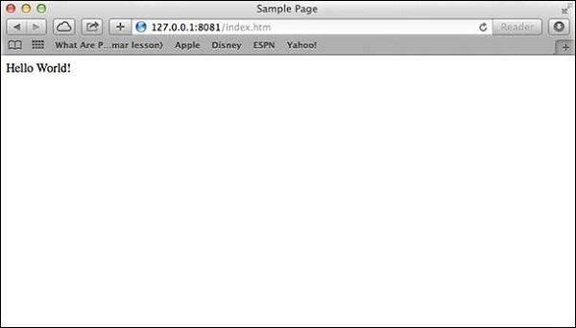
Make a request to Node.js server
Open http://127.0.0.1:8081/index.htm in any browser to see the following result.

Slide 31
Node.js - Express Framework
Express is a minimal and flexible Node.js web application framework that provides a robust set of features to develop web and mobile applications. It facilitates the rapid development of Node based Web applications. Following are some of the core features of Express framework −
Allows to set up middlewares to respond to HTTP Requests.
Defines a routing table which is used to perform different actions based on HTTP Method and URL.
Allows to dynamically render HTML Pages based on passing arguments to templates.

Slide 32
Node.js body-parser
Node.js body parsing middleware.
Parse incoming request bodies in a middleware before your handlers, available under the req.body property.
The bodyParser object exposes various factories to create middlewares. All middlewares will populate the req.body property with the parsed body when the Content-Type request header matches the type option, or an empty object ({}) if there was no body to parse, the Content-Type was not matched, or an error occurred.
var bodyParser = require('body-parser')

